Slide 1
Tutorial Guide
Generated by TutorialFriend

Slide 2
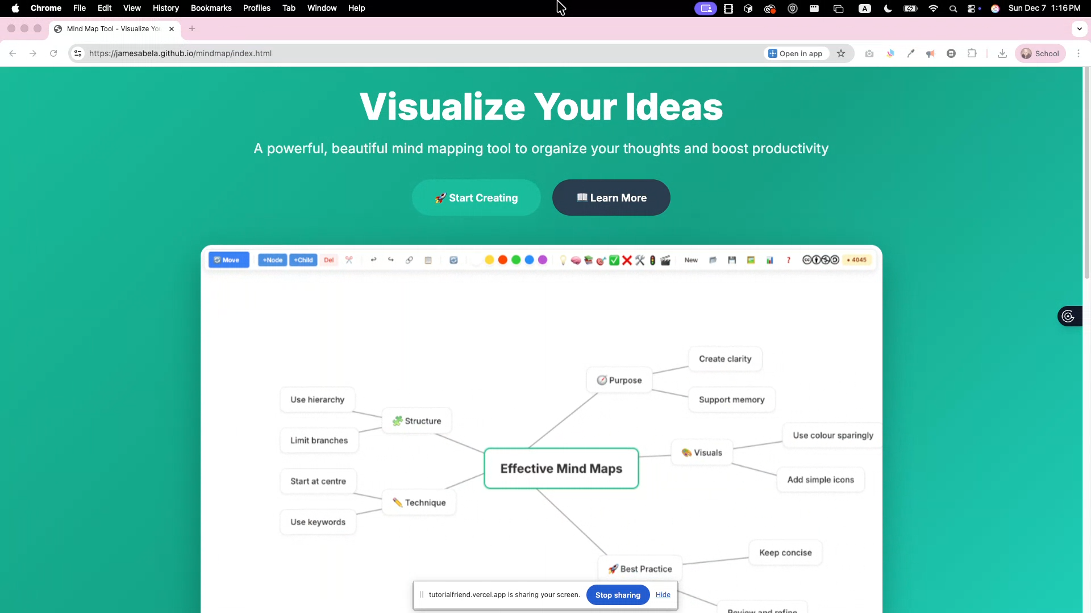
1
Go to
https://github.com/jamesabela/mindmap to get started

Slide 3
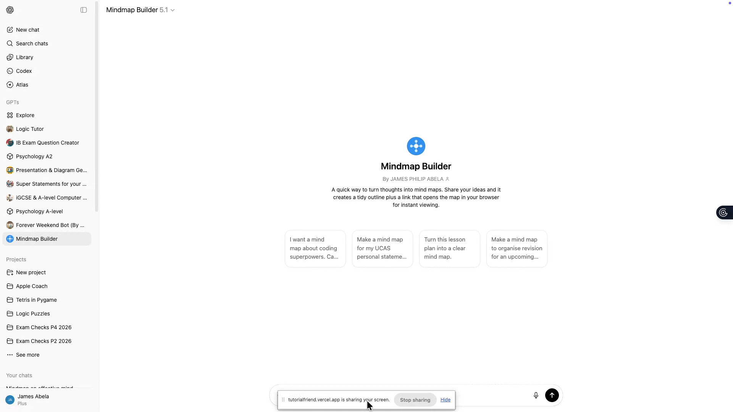
2
You can use this customGPT to generate a Mindmap for you.

Slide 4
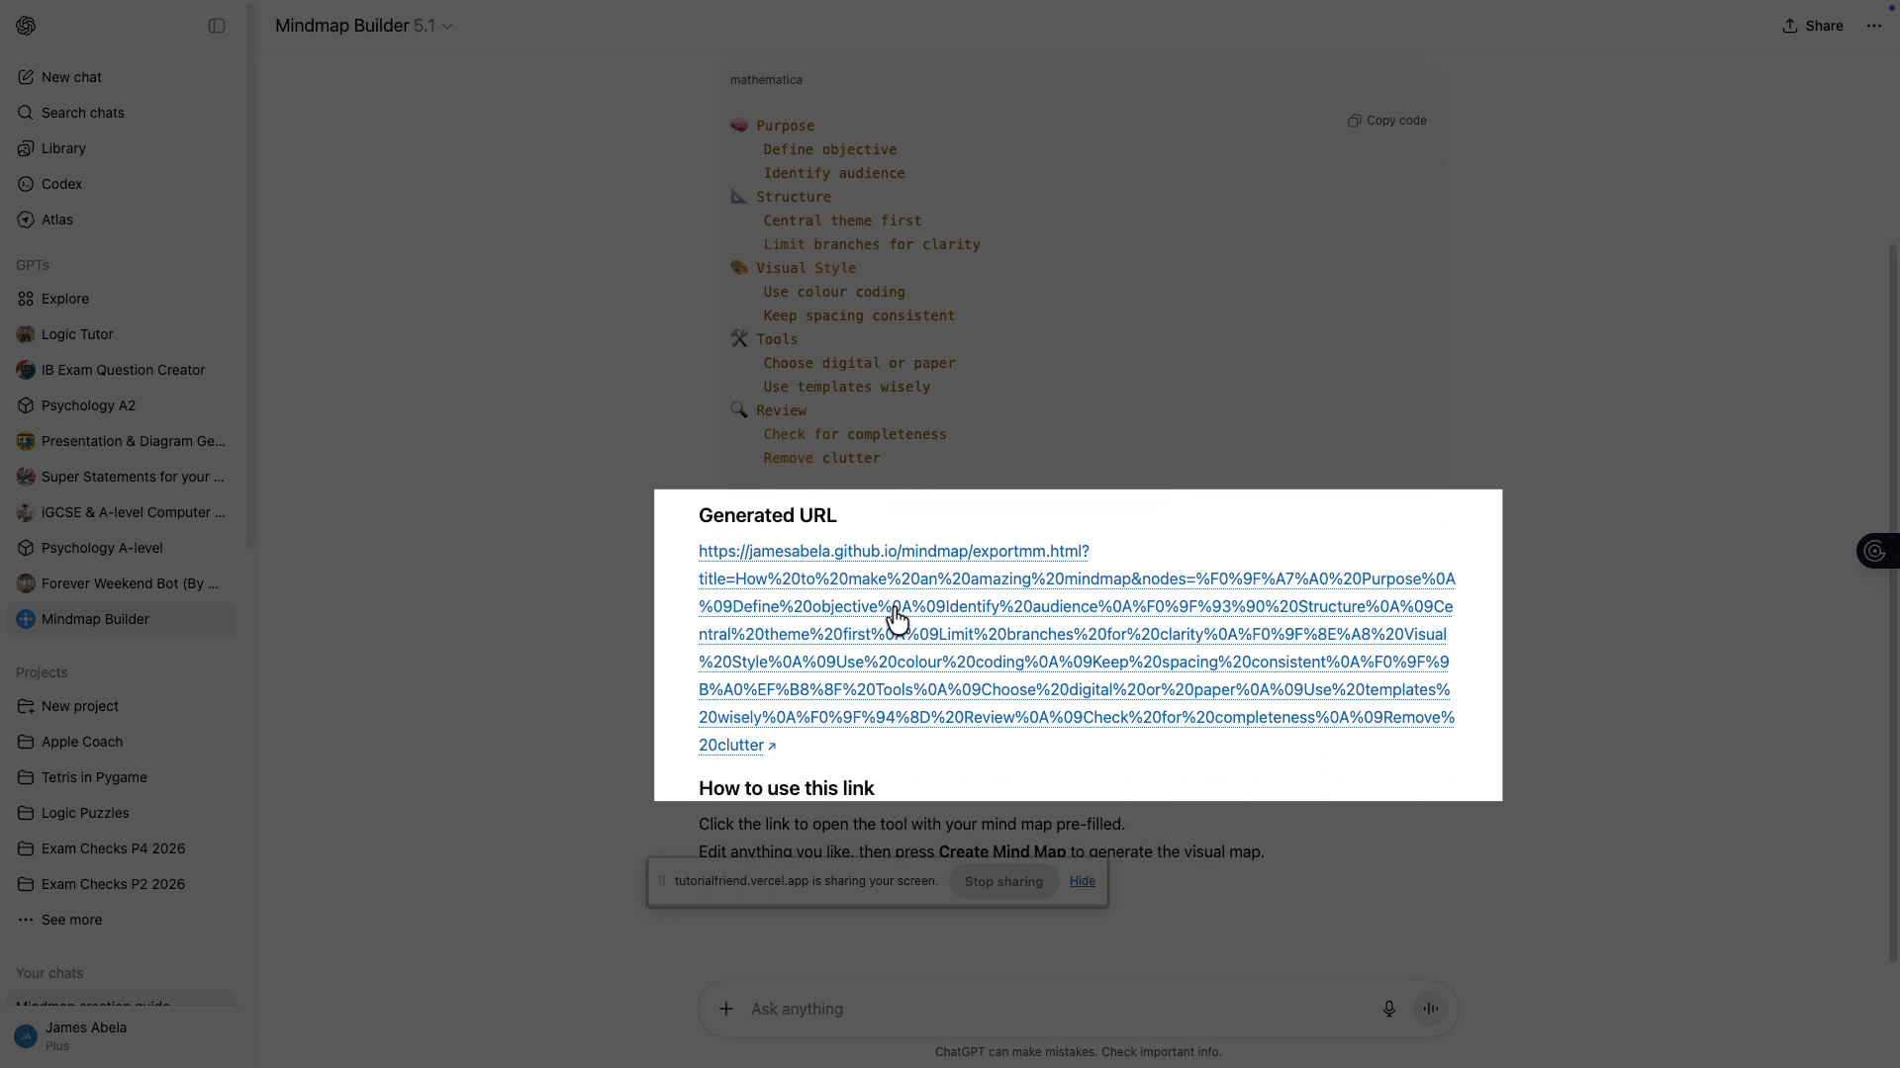
3
Click on the link to generate.

Slide 5
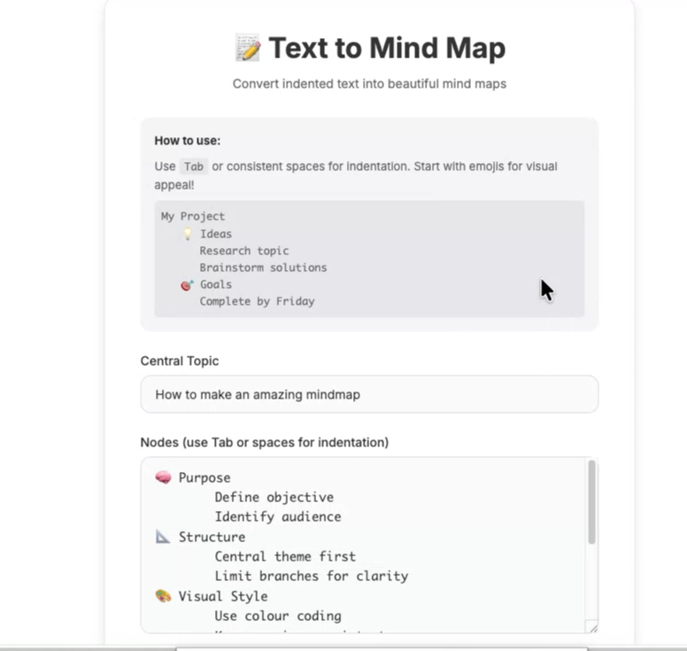
4
It will generate topic and Nodes for you. You can still edit if you please before making a Mindmap. Alternatively you can start with a blank Mindmap.

Slide 6
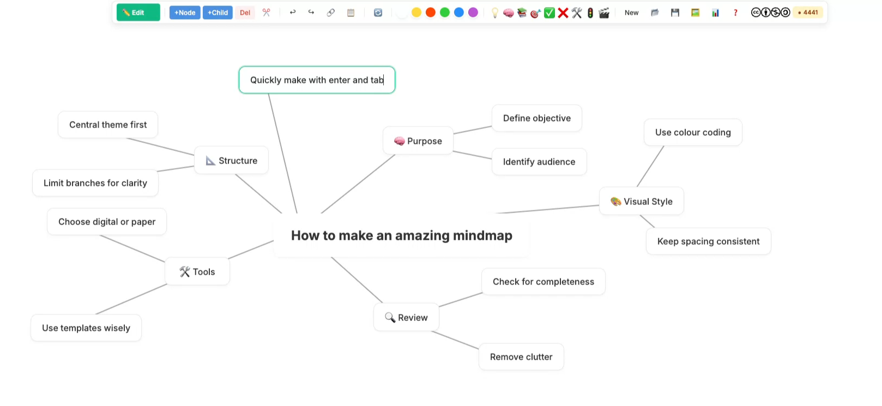
5
Use Enter and Tab to quickly create new nodes.

Slide 7
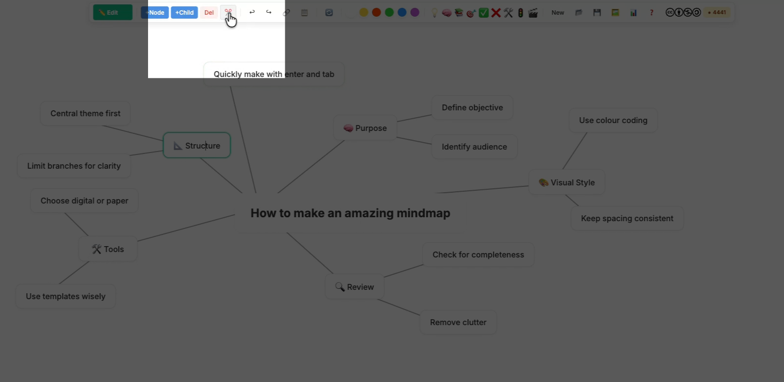
6
If your Mindmap gets too big use the snipping tool to put the node and its children into a new mindmap.

Slide 8
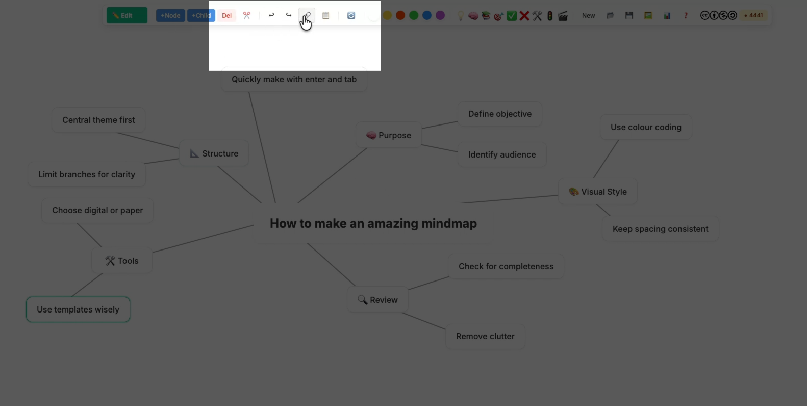
7
You can create links and images with the link button.

Slide 9
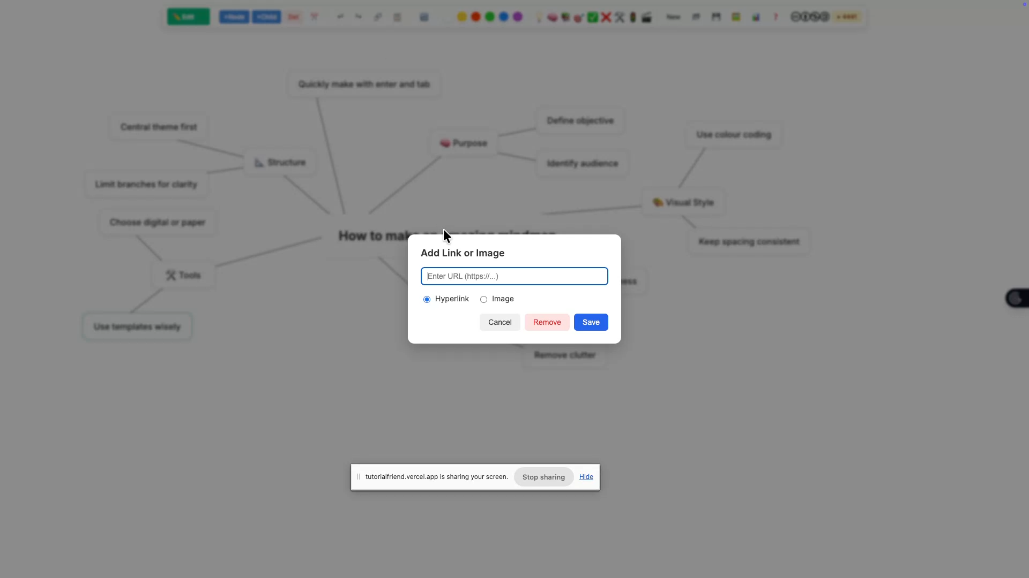
8
Just copy and paste or type the link you want.

Slide 10
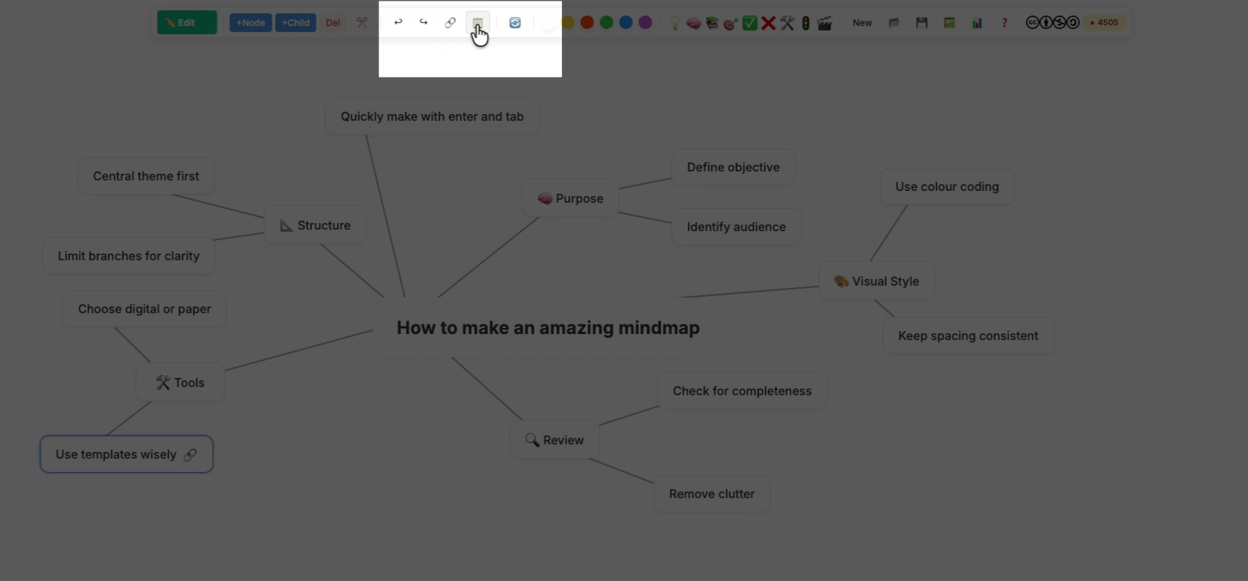
9
Use the clipboard to either copy all the text or for quick text editing of the Mindmap

Slide 11
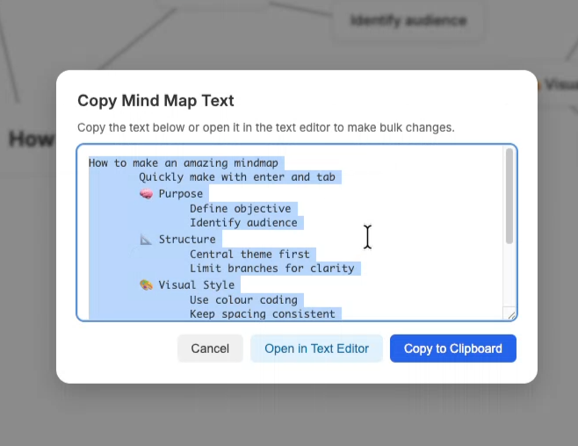
10
Either copy to the clipboard for use in PowerPoint, slides, Keynote or a word processor or you can use the built in text editor to edit the Mindmap itself.

Slide 12
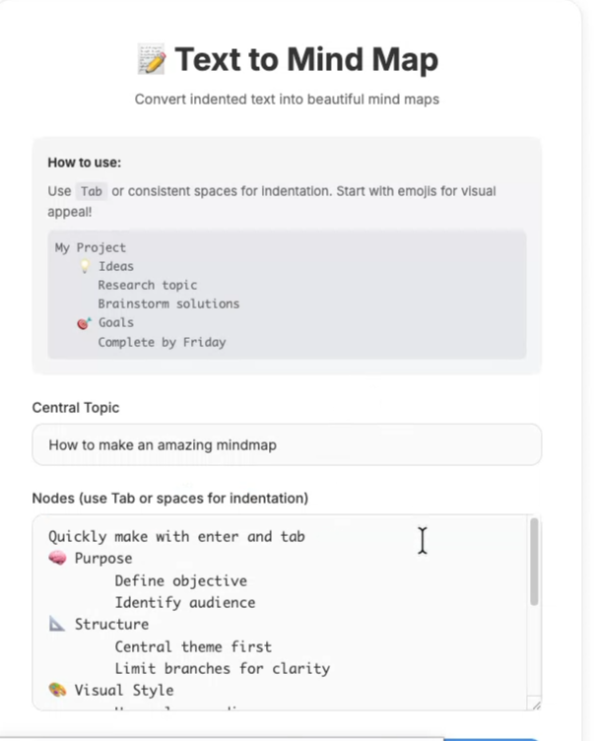
11
Here you can edit the Mindmap as text and make a new design.

Slide 13
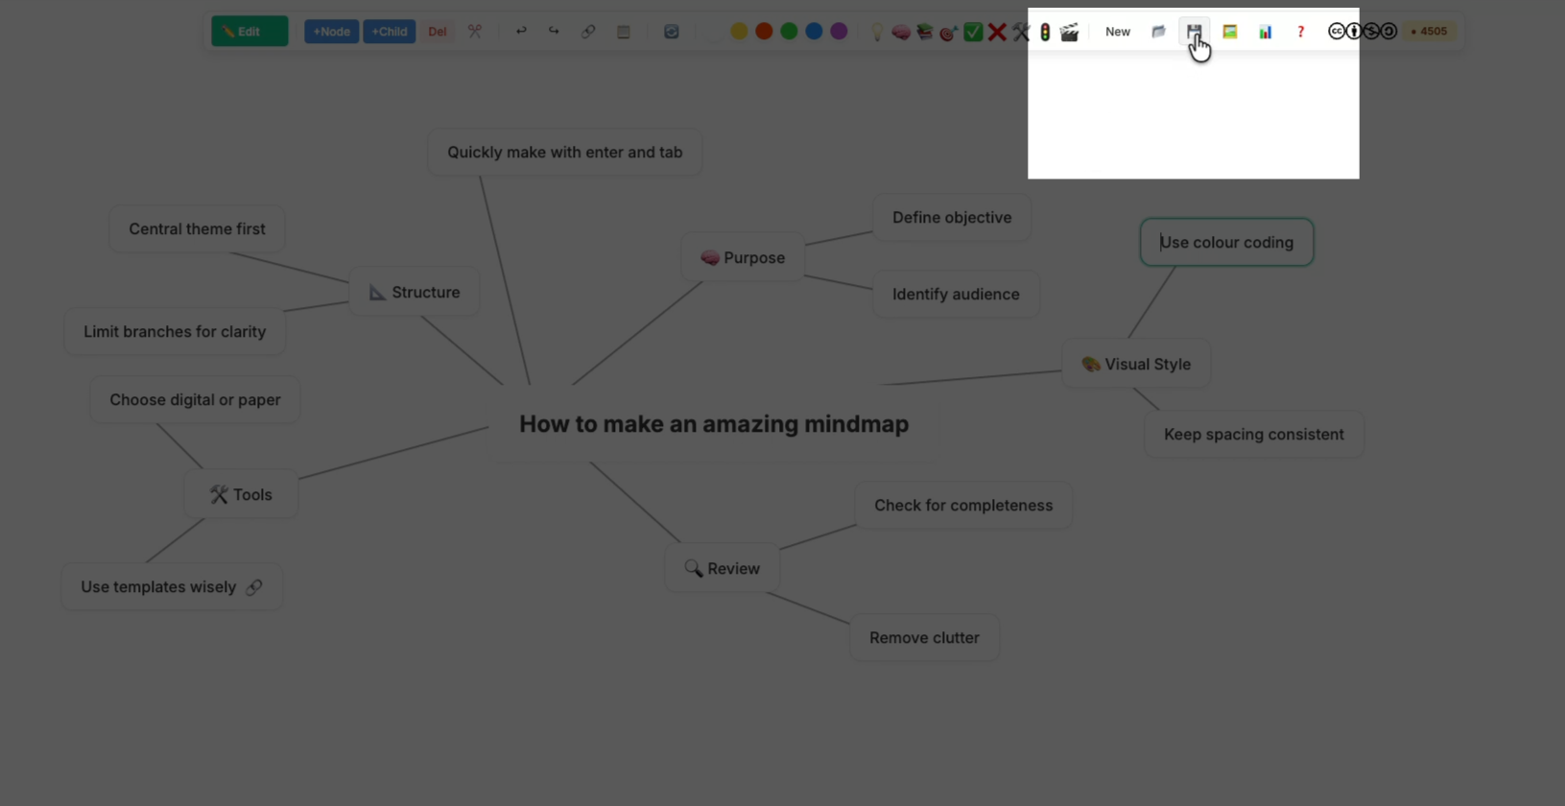
12
You can save your Mindmap to your computer.

Slide 14
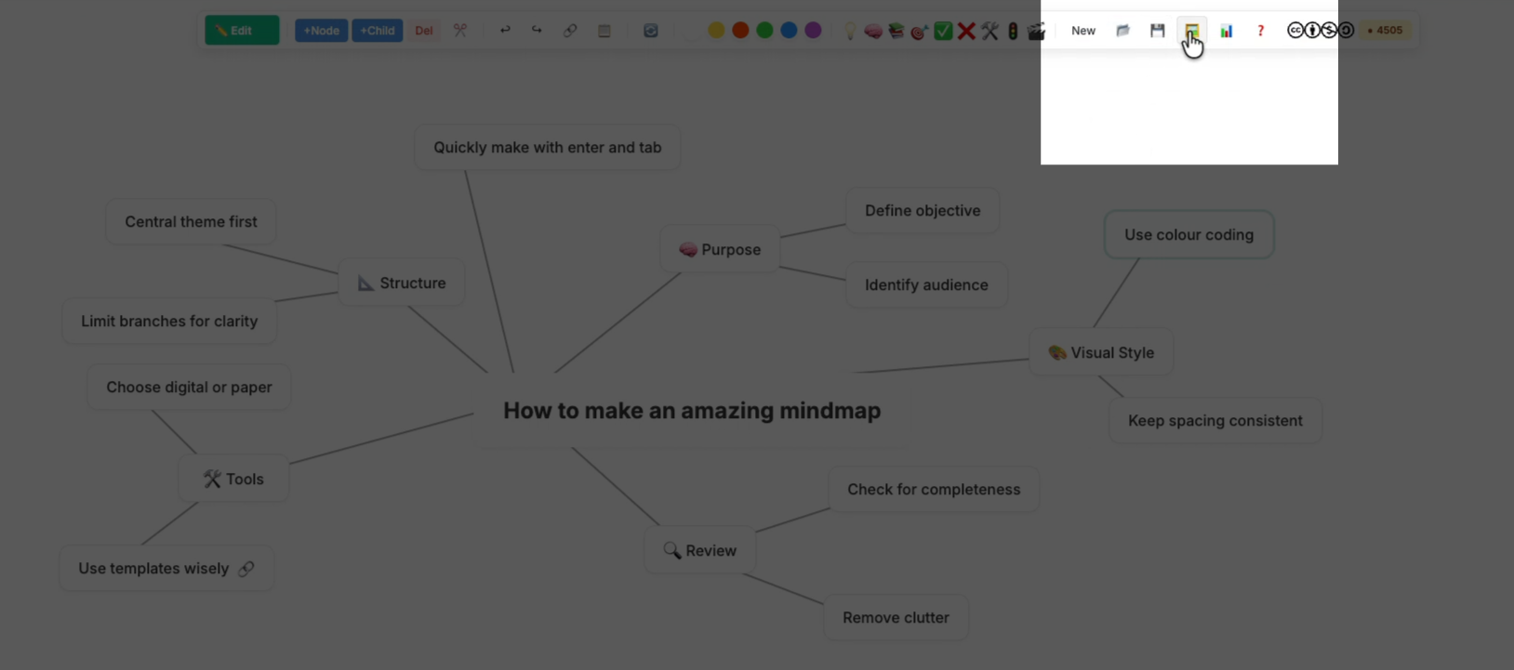
13
You can save an image.

Slide 15
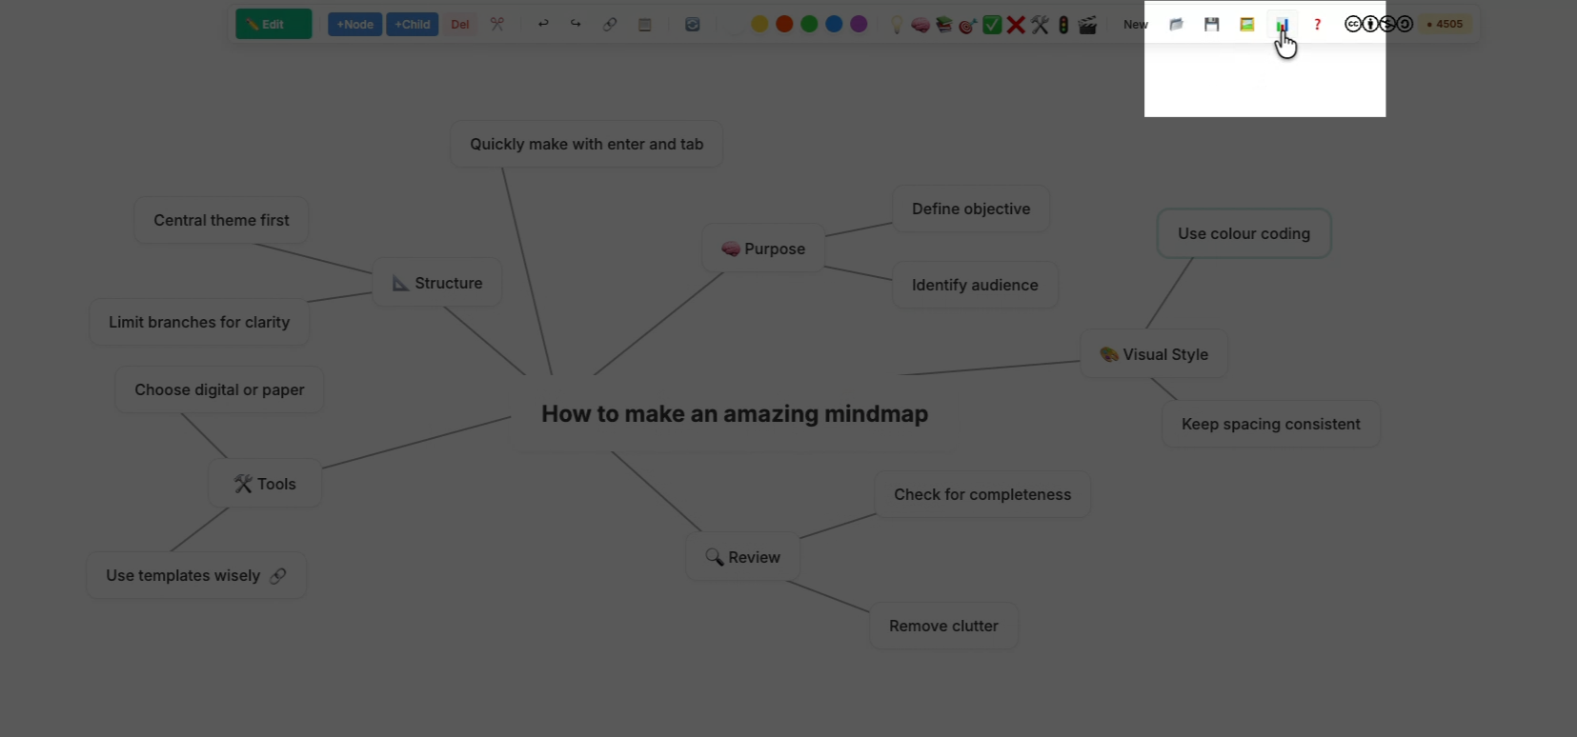
14
You can save a PowerPoint file.

Slide 16
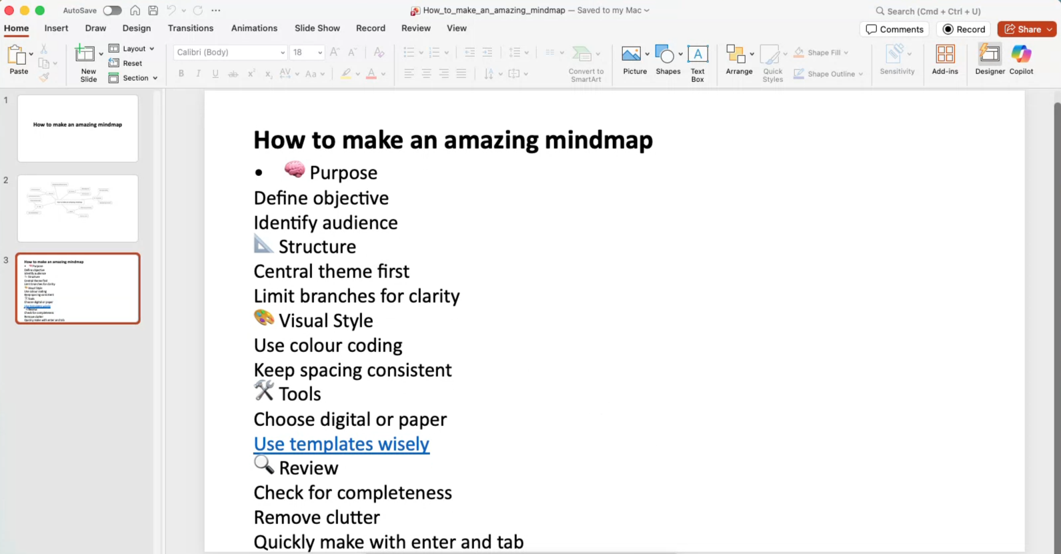
15
Example PowerPoint file.

Slide 17
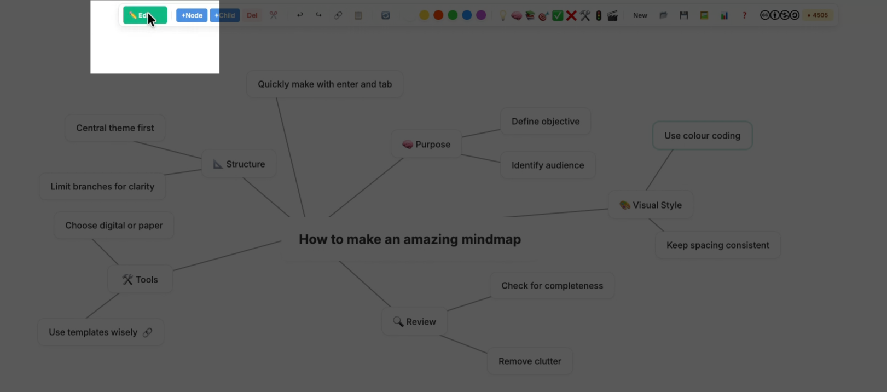
16
You can change from edit to move mode. This is useful for interactive whiteboards and to reorganize your mindmap.

Slide 18
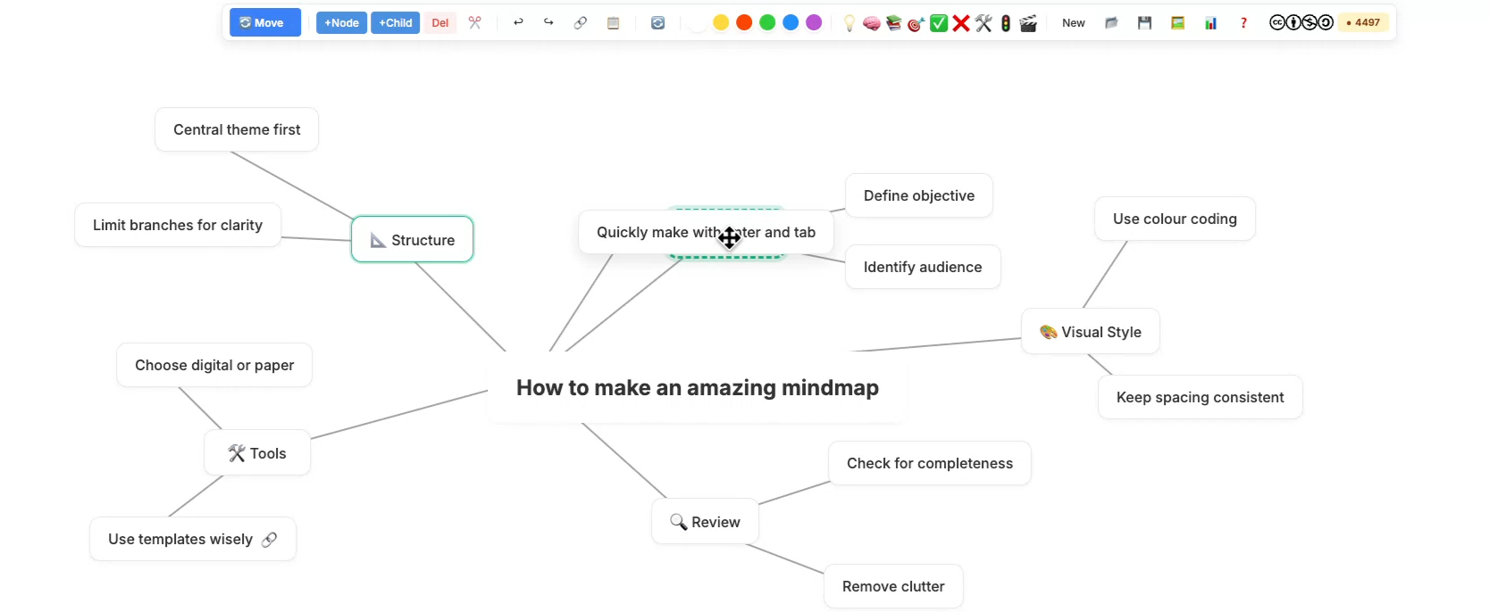
17
If you drag onto another node then it will become a child mode of it.

